Slide 1
IPL PREDICTION
Big Data Project

Slide 2
PEOPLE INVOLVED:
LORICK JAIN – 01FB14ECS104
KALPITHA -
MANSI -

Slide 3
ANALYSIS:
Given a data set use appropriate probabilistic methods to predict a ball to ball statistic involving statistical classification and predict the result.
How did we proceed:
Stage 1 : Converted each of the YAML files into CSV, and organized them in hierarchical fashion . Compressed each balls data and clustered batsman and bowler pairs.
Stage 2 : Pushed these files into HDFS .
Stage 3 : Used Hive to calculate subset tables and thus computed the probability statistic using Naïve Bayes Theorem.
Stage 4 : Used mahout to establish confusion matrix and computed probability of a given batsman-bowler set and generated the result by treating it as a validation set.

Slide 4
Naïve Bayes
Simplicity First–simple ideas often work very well
All attributes make contributions to the decision
They are equally important and independent of one another
Unrealistic but simplistic
Useful when large data set is available
Google uses Naïve Bayes classifier to correctmis-spellings that user types in

Slide 5
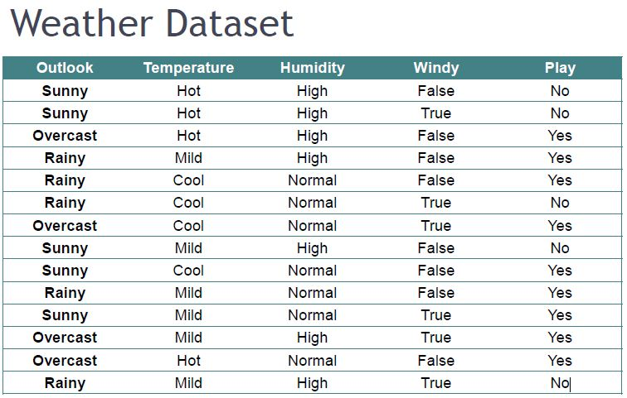
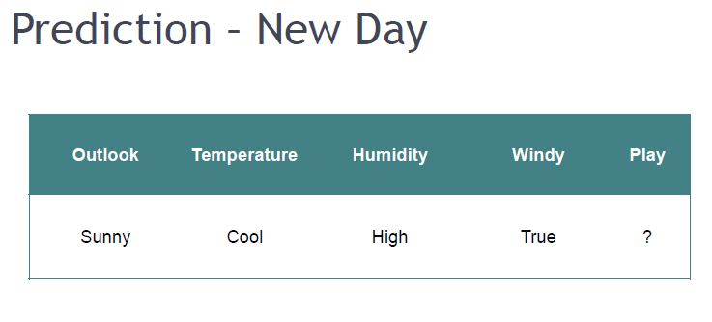
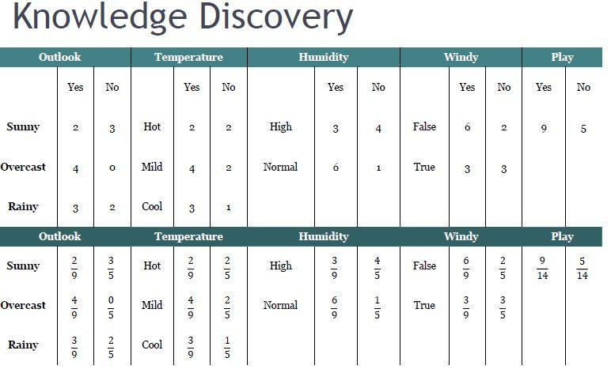
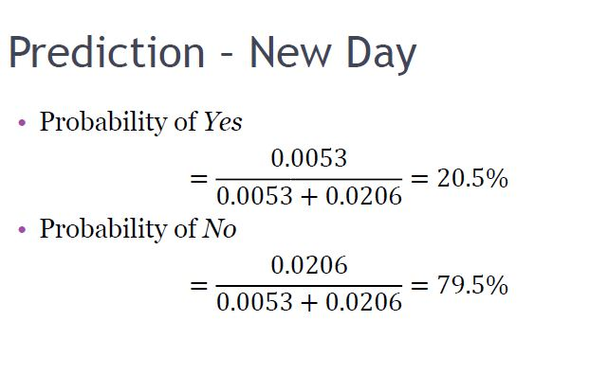

Slide 6
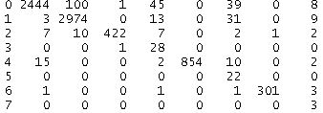
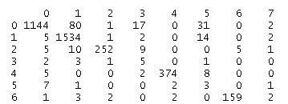
CONFUSION MATRICES FOR TEST AND TRAIN DATA.

